Slide 1
Daily Scrum
08/04
Da Ye Lee Java A-4 SK Didimdol 4th hillofsky@naver.com

Slide 2
Task List
Assigned Task | Progress
Bitbucket, SourceTree 실행 및 개발환경 세팅 | 90%
UI 구현(CSS,JSP) | 0%

Slide 3
Yesterday’s Task
Today’s Task
Technical Issue

Slide 4
1. Yesterday’s Task
What I did?
Bitbucket, SourceTree실행 및 개발환경 세팅

Slide 5
1. Yesterday’s Task
How I did?
Bitbucket, SourceTree 실행 및 개발환경 세팅
Pull 받고 tomcat 실행
JSP 작성 후 commit, push 실행

Slide 6
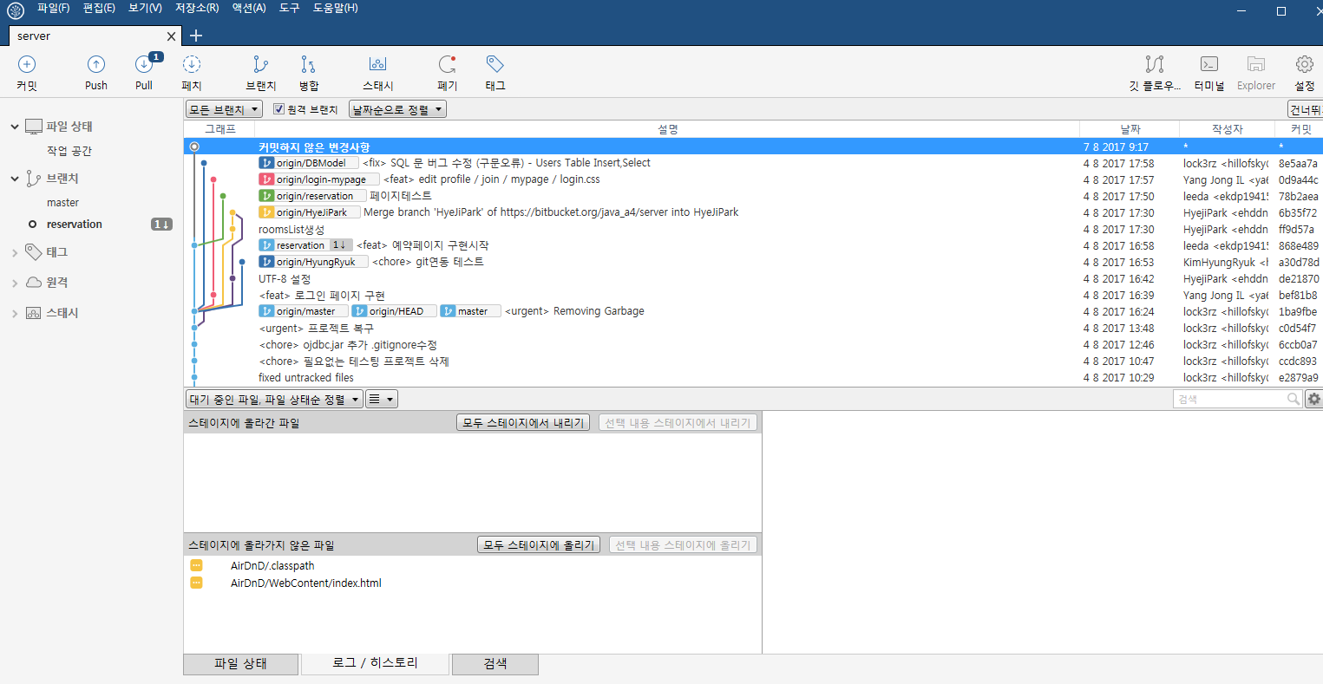
1. Yesterday’s Task
Result

Slide 7
Yesterday’s Task
Today’s Task
Technical Issue

Slide 8
2. Today’s Task
ToDo
UI 구현(CSS,JSP)

Slide 9
Yesterday’s Task
Today’s Task
Technical Issue

Slide 10
3. Technical Issue
Issue
없음

Slide 11
END

